Slide 1


Co-Lock
Smoke & Fluff
Co-working made simple and safe
Hackathon Presentation | May 2017

Slide 2
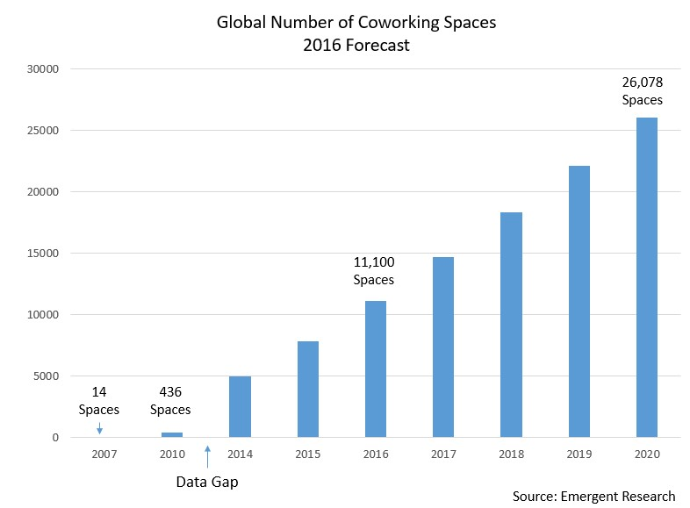

Co-working thrives as startups thrive

Slide 3
Pain Points
Security
Over-Capacity
Inefficiency
Unauthorized entry
Theft of equipment
Theft of IP
Loss of Revenues
Affected Margins
Nuisance drives users away
Manual labor costs
High costs spent on monitoring (CCTV, security guards)

Slide 4

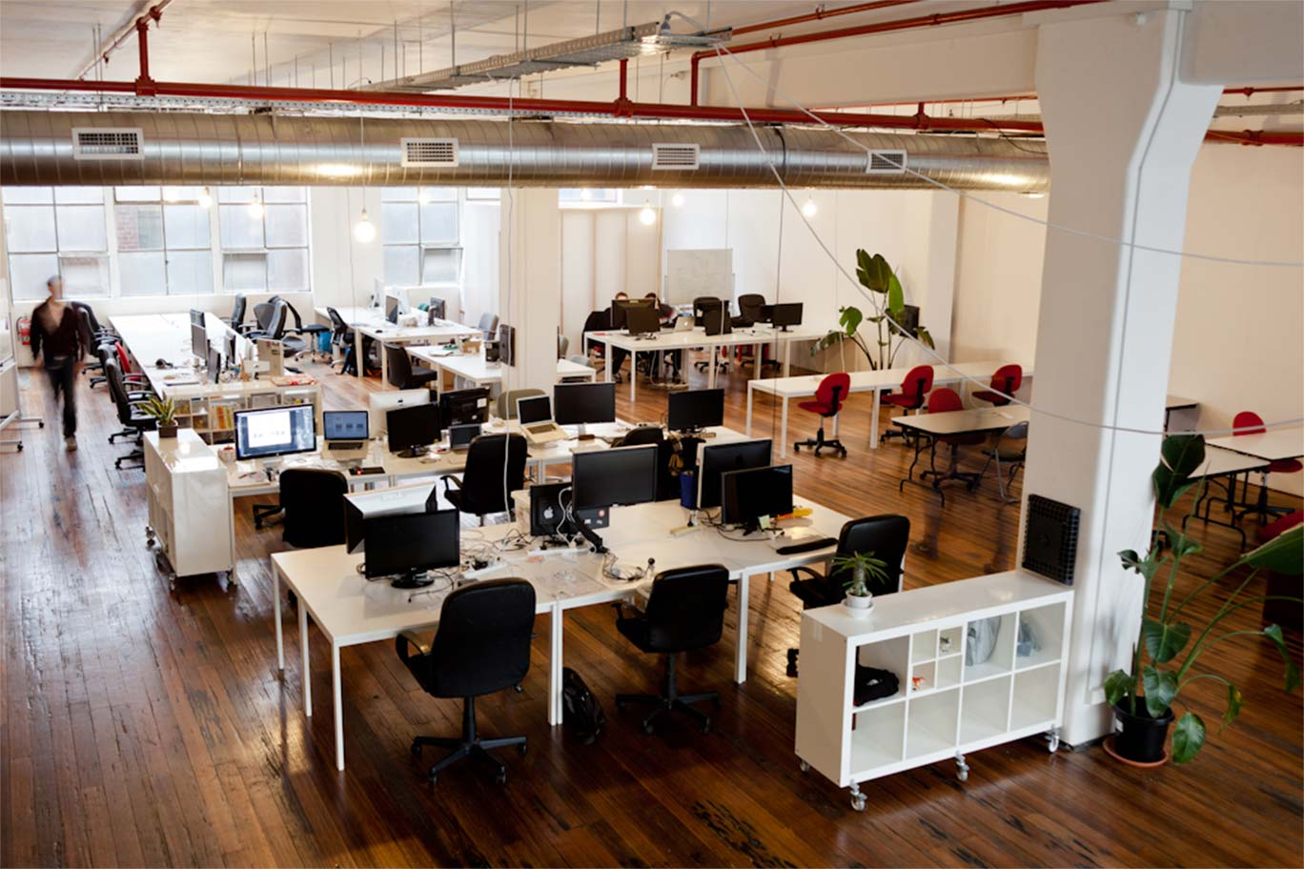
Solution: Co-Lock System
Office Cubicles & Main Entrance
Co-Locks installed at these entry points
QR scan required to unlock the door
Open Tables’ Charging Ports
Co-Locks installed at the charging points
QR scan required to unlock the charging points

Slide 5
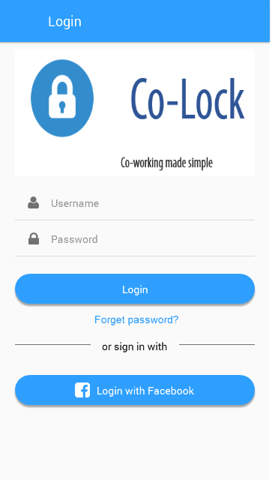
Solution: Co-Lock System
Co-Lock
Web Interface
Smart Lock
QR activated
Restricts access
Control and customize access (rooms)
Manage occupancy
Facility usage analytics
Mobile App
Scan QR to Unlock Rooms
Heatmap of available tables/offices
On-demand booking
Securely store equipment

Slide 6
Product Demo

Slide 7
We automate coworking spaces’ operations and increases security
Scan The Code,
You’re In
Safer Than Ever Before
Highly Scalable
Unbeatable
Cost Savings
One-scan easy access
Accurately restrict unauthorized access
Pipeline developments
to enhance Co-Lock system
Reduce payroll expenses

Slide 8
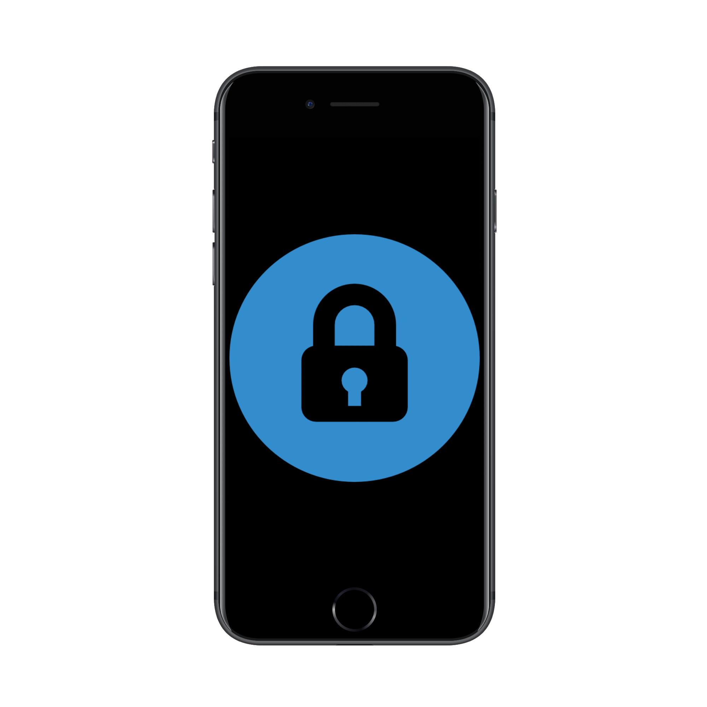
Co-Lock: Pipeline Development
Access Control
Surge Pricing
Map showing vacancy
Users’ access to rooms is customized
May include Wi-Fi control.
Formulas track current occupancy and historical occupancy
Determine surge multiplier to increase revenue
Automated Booking
Light and AC Control
Scan-to-book
Increased convenience during off-peak hours
Detects human presence in room
Switches lights and AC on-off
Compulsory scanning allows better AC control

Slide 9


B2B Security Management is Ripe for Disruption
Top Market (20%)
Large contracts – MNC, large offices/facilities
Text
Text
Middle Market (70%)
Small to Medium coworking spaces at limited scale
Lack efficient facility management system
Text

Slide 10











We target medium-sized co-working spaces

Slide 11
Large immediate market with huge growth in Singapore
$400M Co-Working Market
16.4% CAGR
$1.98B Residential Lease Market
5.3% CAGR
$170M Bike-Sharing Market
26% CAGR

Slide 12
SaaS model with free lock implementation
Charge 2% of lease price
Estimated ARR of $0.90M after 1-year operation
High Life-Time Value (as opposed to partnering with AirBnb hosts)
Target initial 10 offices
Average 8,000sqf (250 seats)
Lease prices between $30-$60/day

Slide 13
Go-to-market Strategy
Today we build locks, tomorrow we build homes
Product-Market Fit
Penetrate
Expansion
Targets 3 co-working operators
Spacemob
Regus
Spaces
Customer Acquisition
Drive App installs
Educate users
Partners with lock-makers
Specialize
Control Value Chain
Aggressively sells to other co-working operators
Vertical Business Line
AirBnb
Bike-Sharing
Phone Lease
Geographical Expansion
Vietnam (Hanoi, HCMC)
Others with strong startup movement

